Slide 1
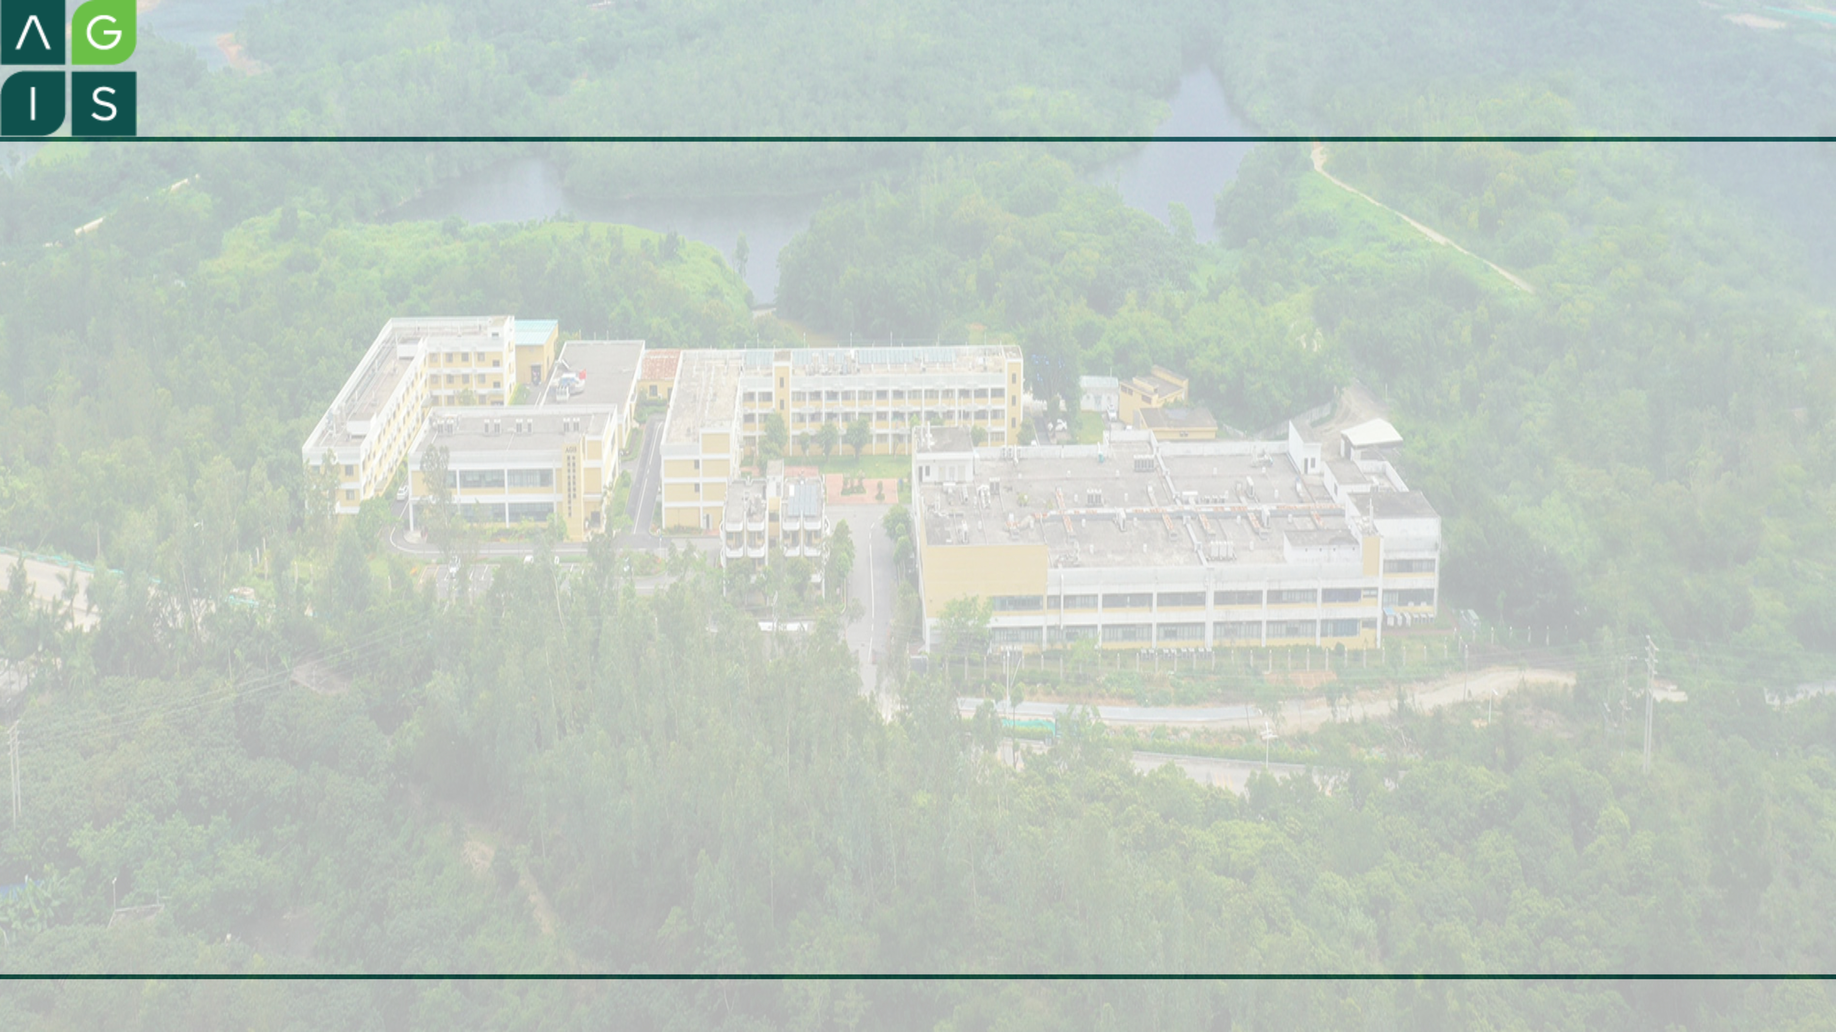
Introducing Python
Zou Yi & Li Cheng
2021-11-3 18:30~7:15

Slide 2

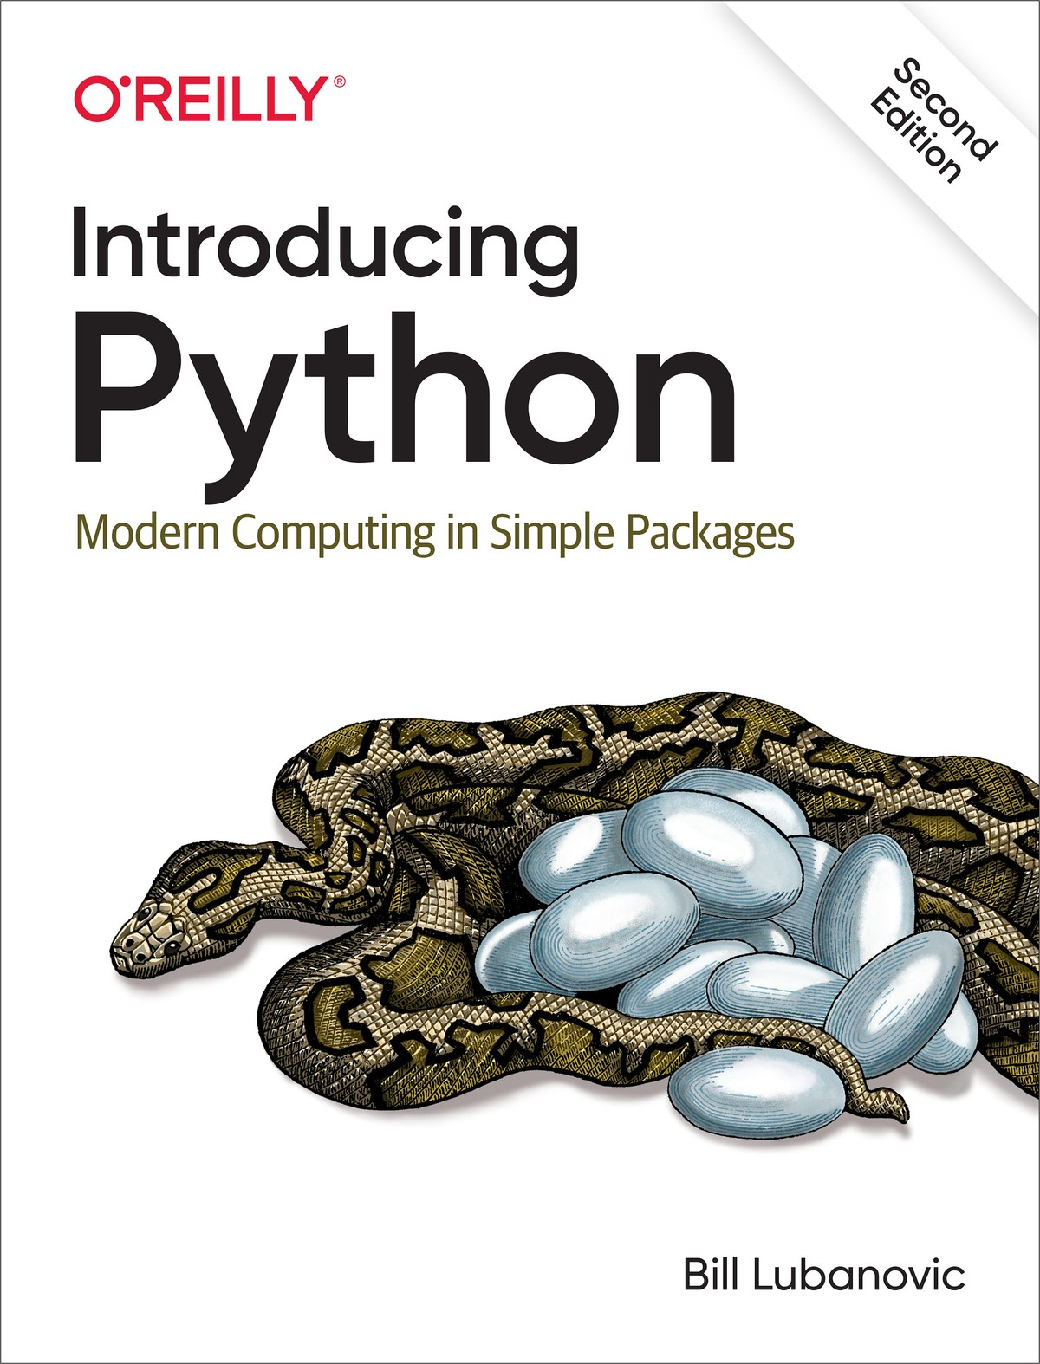
Introducing Python
git clone https://github.com/madscheme/introducing-python
What to expect from the book?
Language fundamentals
Coding tips and tools
Domain-specific tasks

Slide 3
Overview
Introduction
Language Fundamentals
Files and Directories
Modules and Packages
Python and Bioinformatics

Slide 4
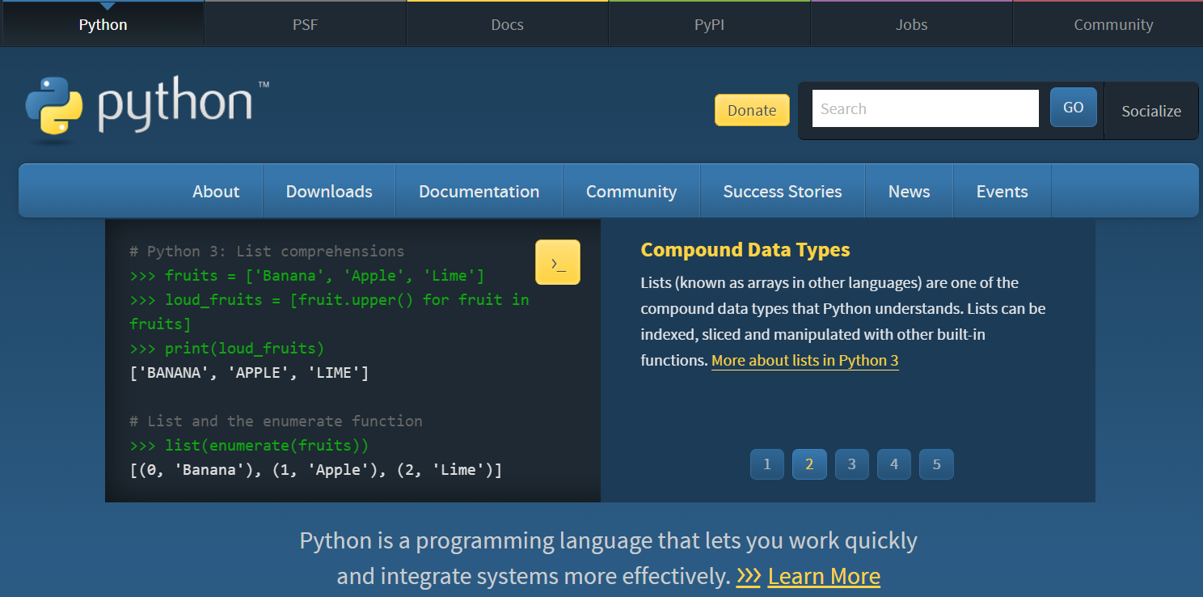
1. Introduction
https://www.python.org/

Slide 5
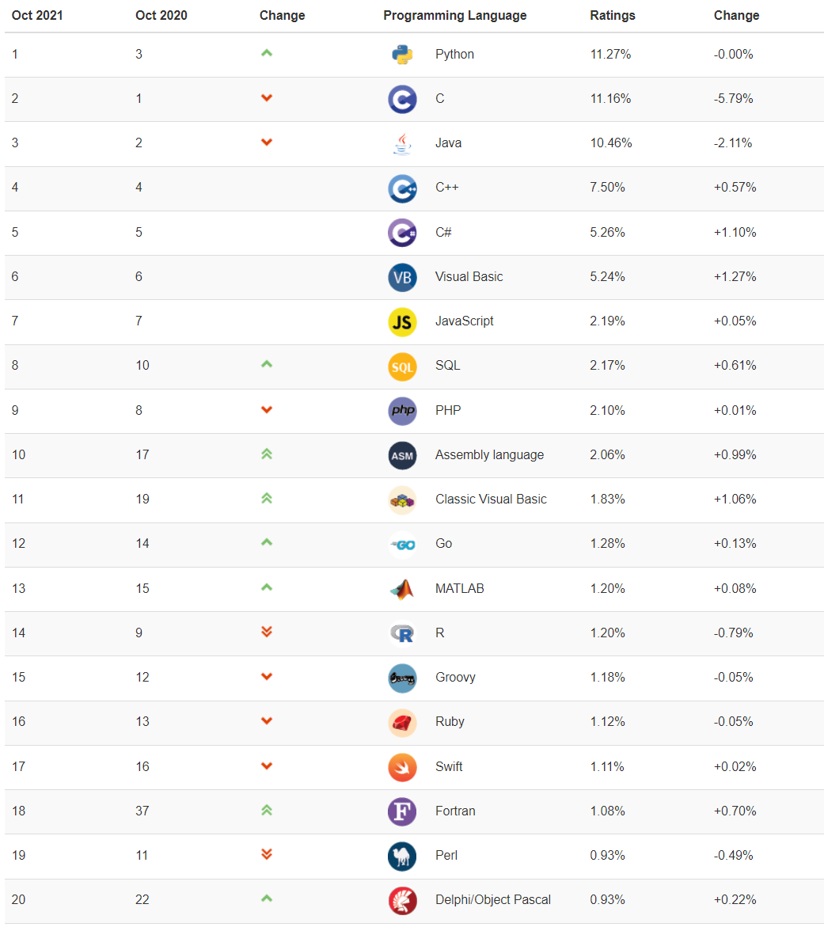
What is Python?
Python is a general-purpose programming language.
Python is a very high-level language (VHLL).
Python is an object-oriented programming language.
https://www.tiobe.com/tiobe-index/
Notes:
$ wget -c https://www.python.org/ftp/python/3.9.7/Python-3.9.7.tgz
$ tar -zxvf Python-3.9.7.tgz
$ cd Python-3.9.7.tgz
$ ./configure --prefix=/usr/software/python-3.9.7 --enable-optimizations
$ make
$ make install

Slide 6
Installing Python
Step 1:
$ wget -c https://www.python.org/ftp/python/3.9.7/Python-3.9.7.tgz
$ tar -zxvf Python-3.9.7.tgz
$ cd Python-3.9.7
$ ./configure --prefix=/usr/software/python-3.9.7 --enable-optimizations
$ make -j 4
$ make install
$ ln -sf python python3.9
Step 2:
add the following line to your ~/.bashrc file:
export PATH="/usr/software/python-3.9.7/bin":$PATH

Slide 7
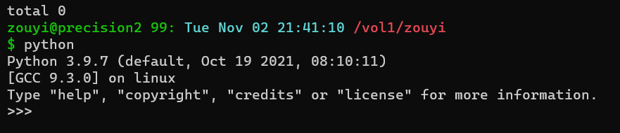
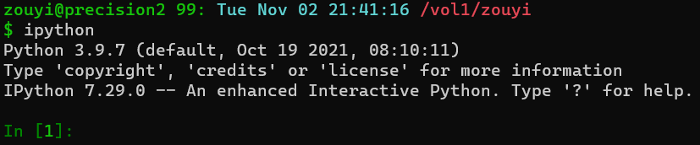
The Interactive Interpreter

Slide 8
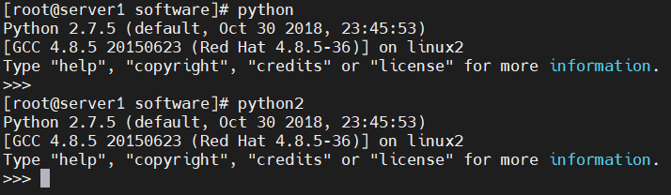
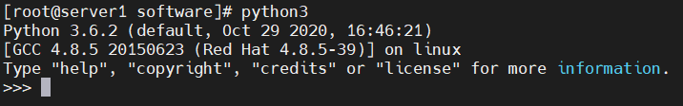
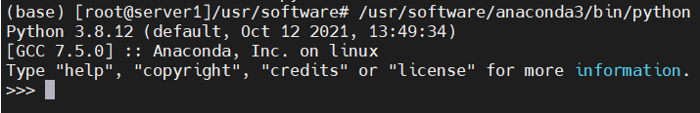
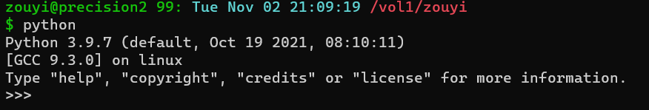
Python2 and Python3
$ which python
$ which python2
$ which python3

Slide 9
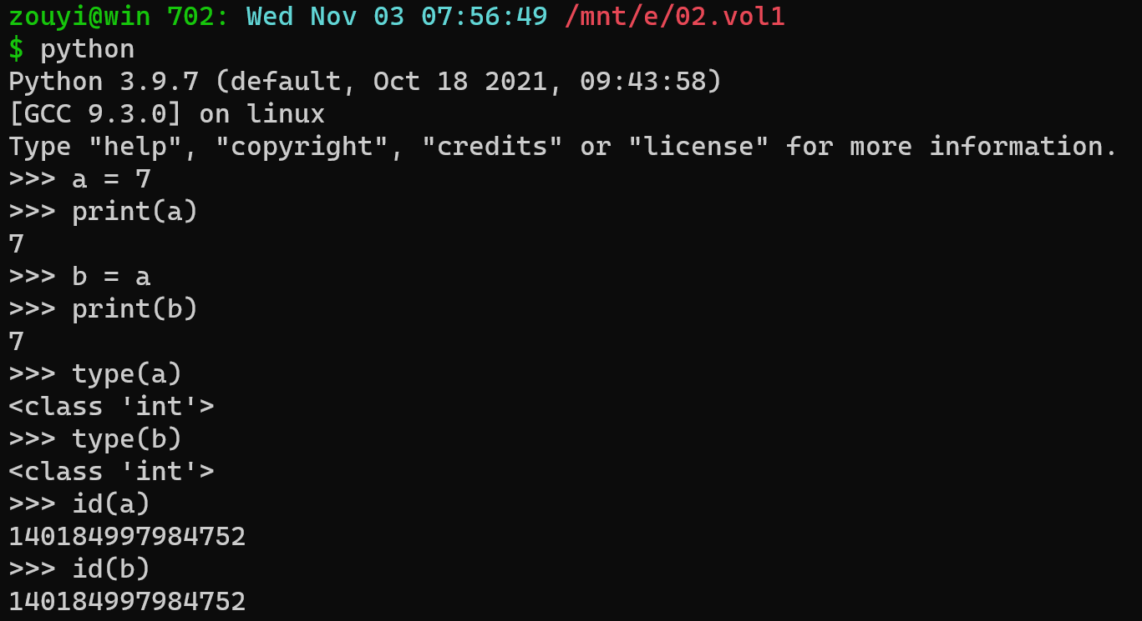
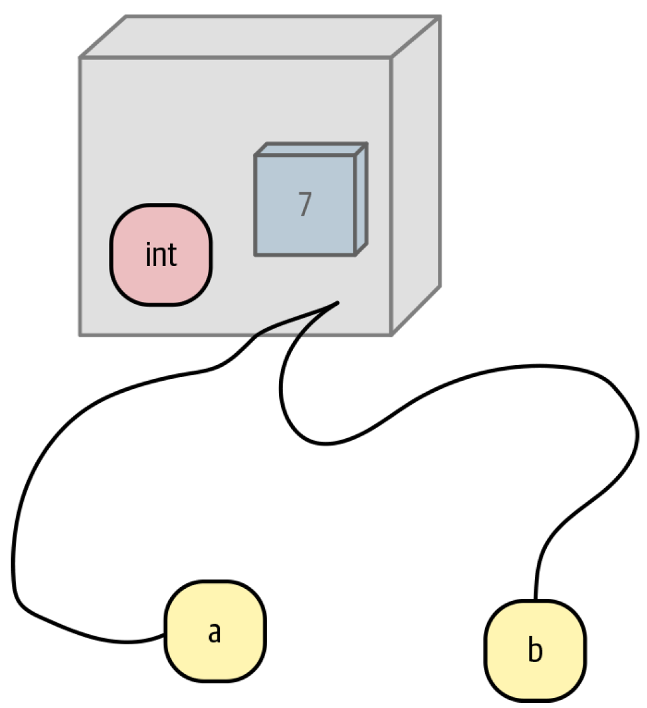
2. Language fundamentals
Everything is implemented as an object.

Slide 10
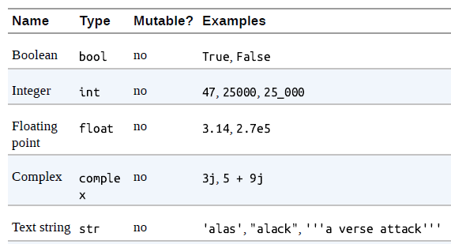
Python’s basic data types
numbers and strings

Slide 11
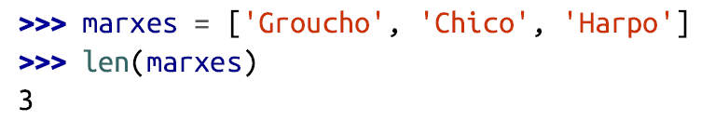
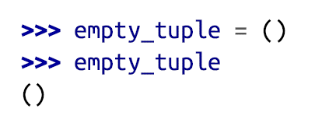
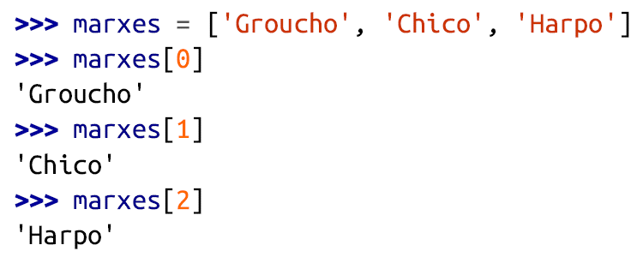
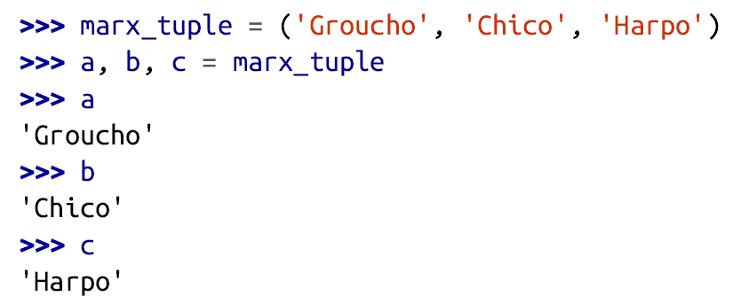
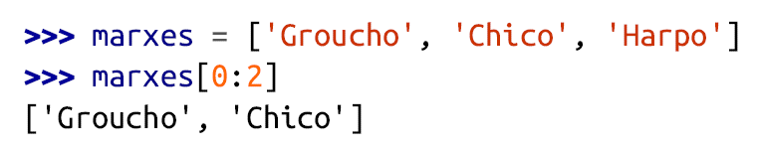
Data structures: Tuples and Lists
Tuples and lists are sequences of any Python objects.
The elements can be of different types.
len
offset
tuple unpacking
slice

Slide 12
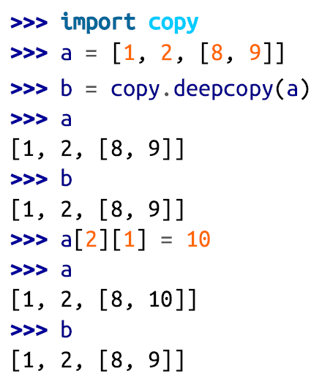
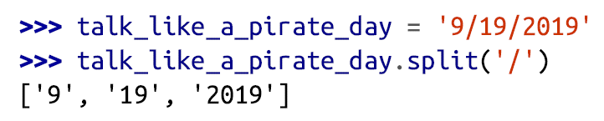
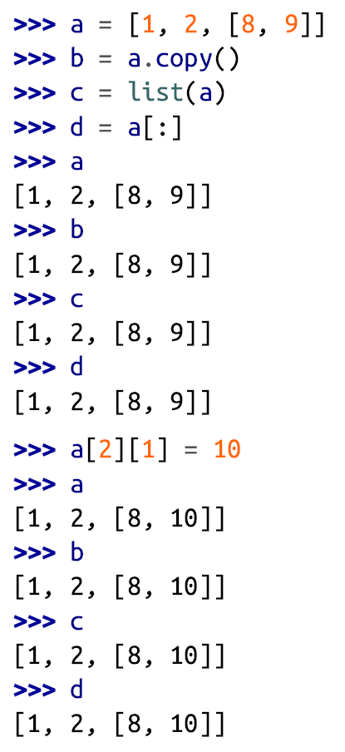
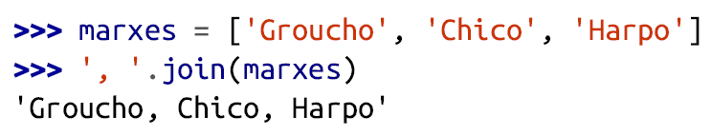
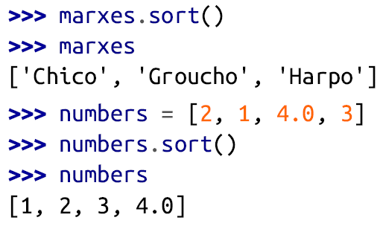
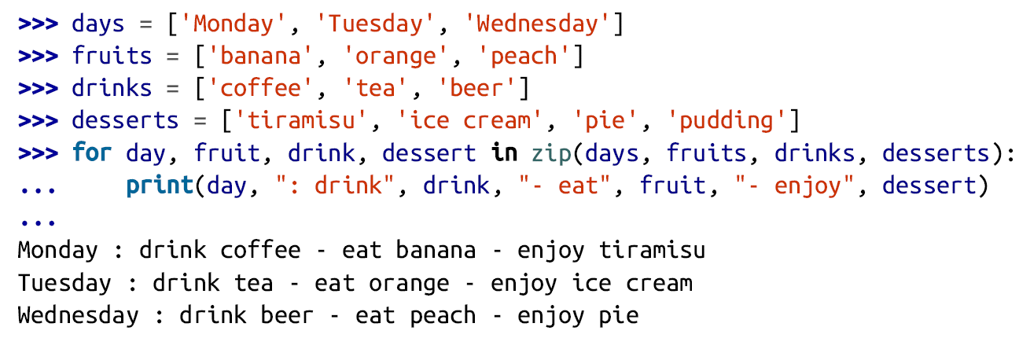
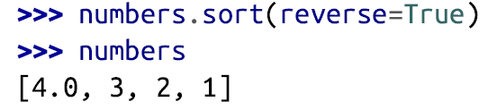
List Operations
split
copy
deepcopy
join
sort
zip

Slide 13
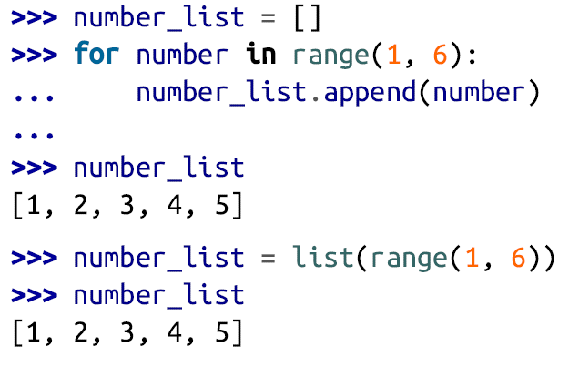
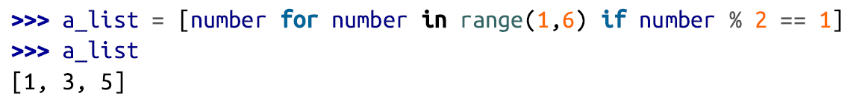
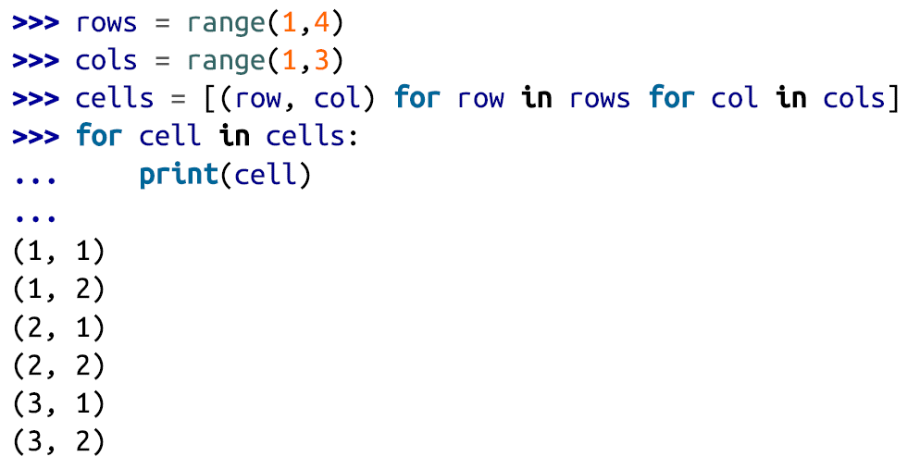
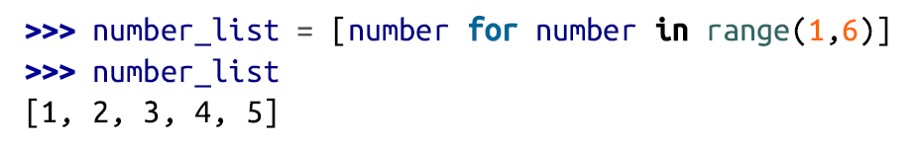
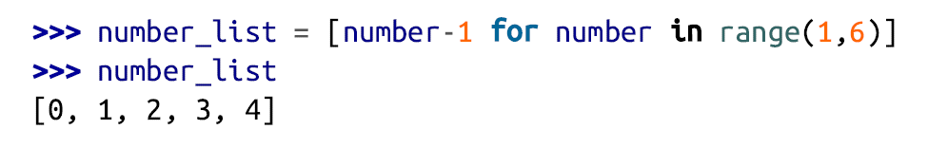
List Comprehension
[expression for item in iterable if condition]

Slide 14
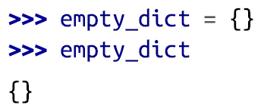
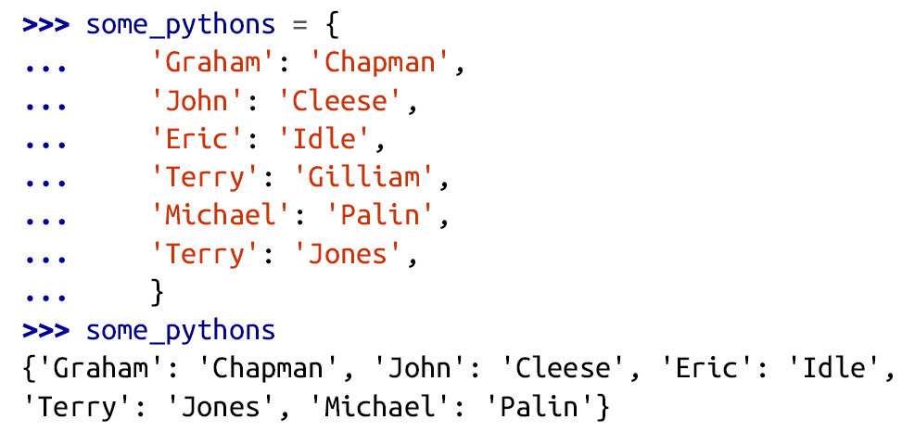
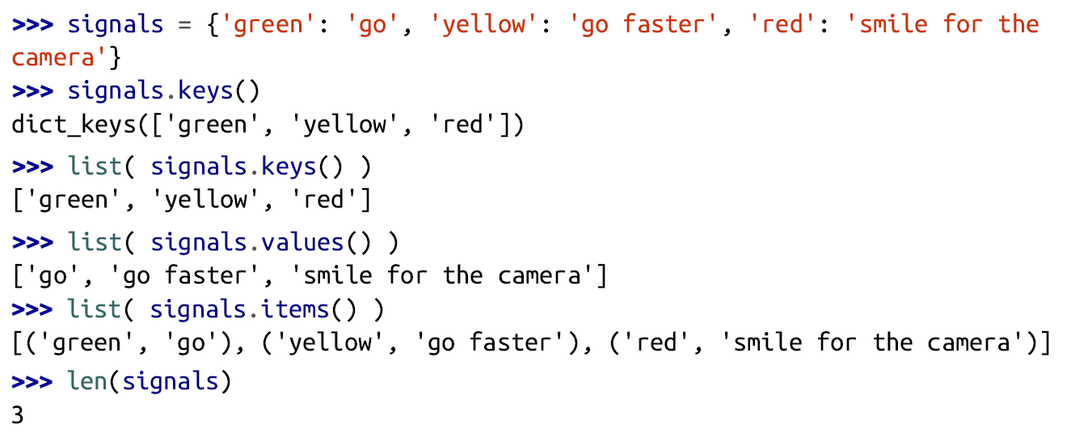
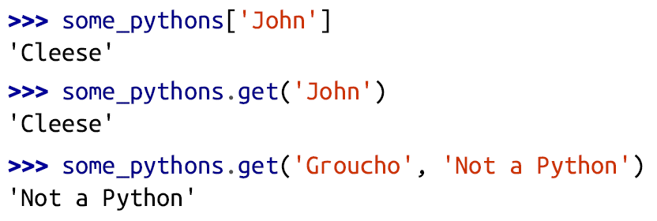
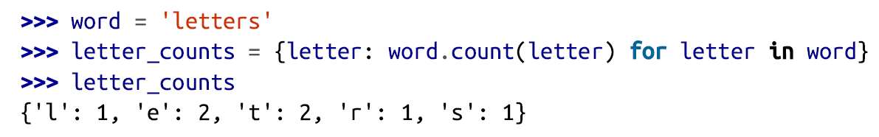
Data structures: Dictionaries and Sets
A dictionary is similar to a list, but the order of items doesn’t matter.
You specify a unique key to associate with each value.
Dictionary comprehension

Slide 15
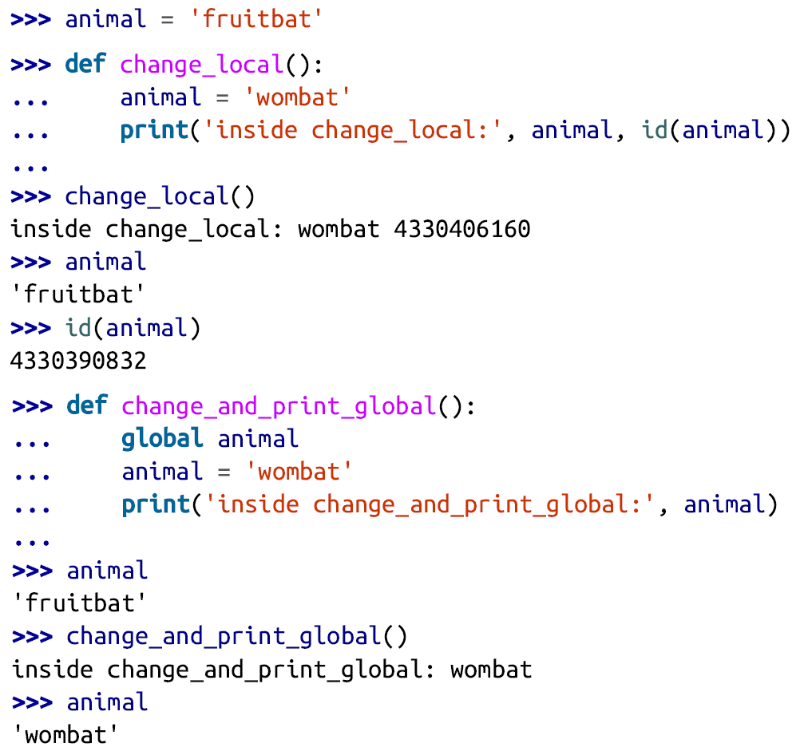
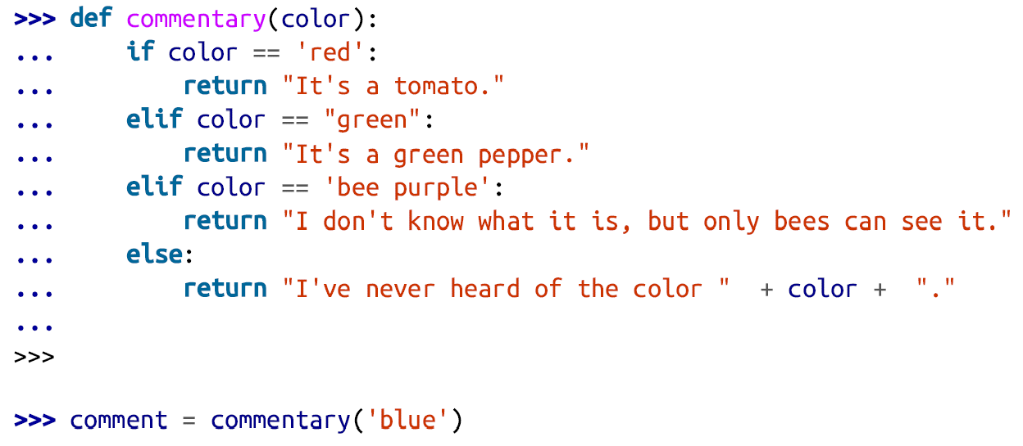
Functions
The first step to code reuse is the function: a named piece of code, separate from all others.
A function can take any number and type of input parameters and return any number and type of output results.
You can do two things with a function:
Define it, with zero or more parameters
Call it, and get zero or more results
namespace

Slide 16
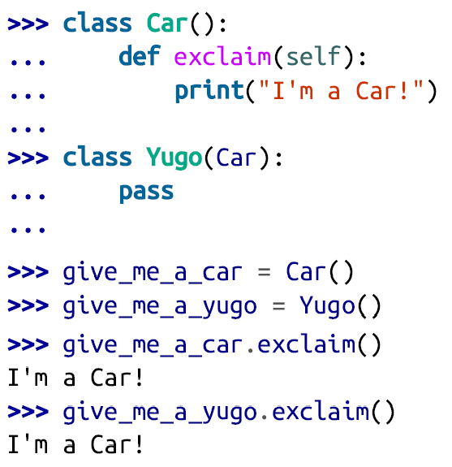
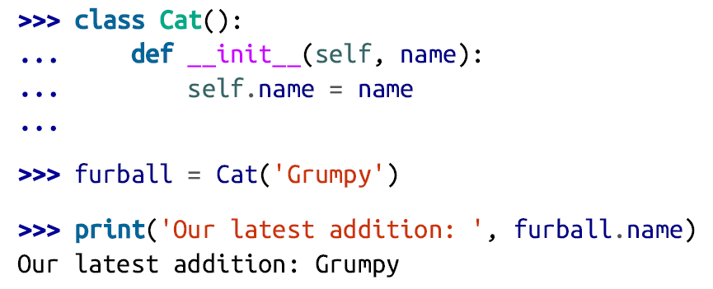
Objects and Classes
The only time you need to look inside objects is when you want to make your own or modify the behavior of existing ones.
An object is a custom data structure containing both data (variables, called attributes) and code (functions, called methods).
An object represents an individual thing, and its methods define how it interacts with other things.

Slide 17
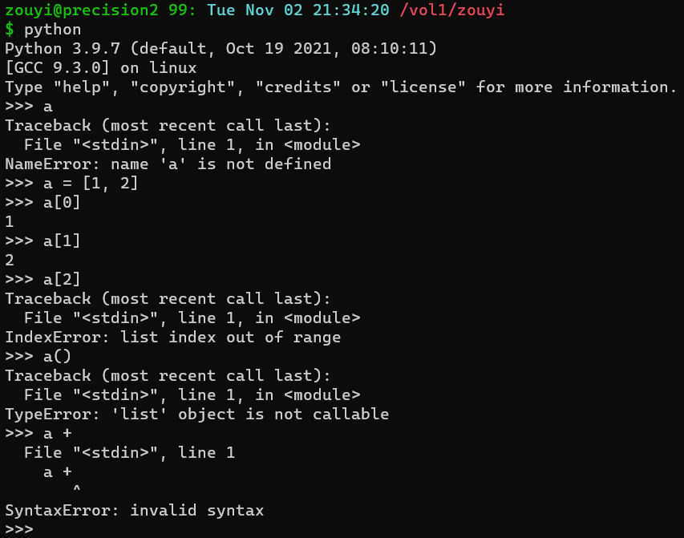
Exceptions
NameError
IndexError
TypeError
SyntaxError

Slide 18
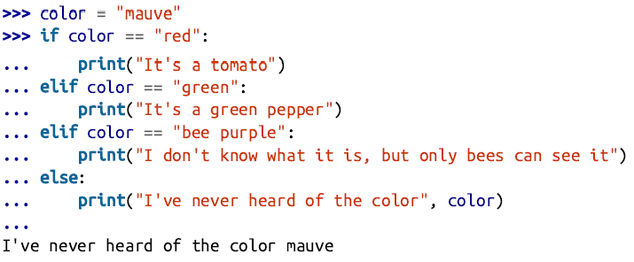
Control structures: condition
boolean values:
True or False
comparison operators:
==, !=, <, <=, >, >=, in
boolean operators:
and, or, not

Slide 19
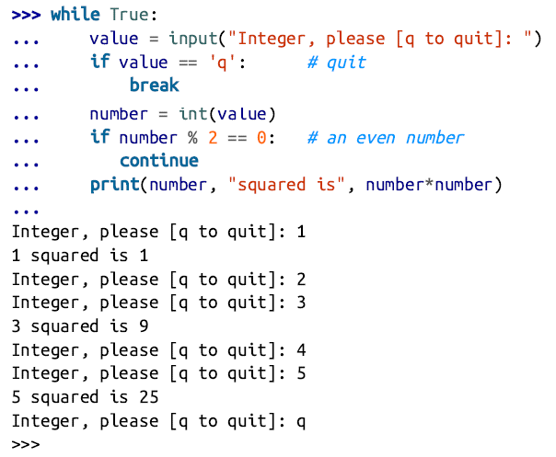
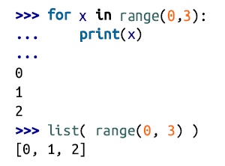
Control structures: loop

Slide 20
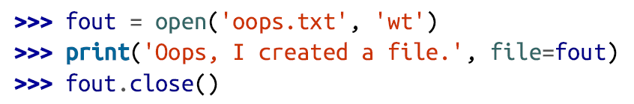
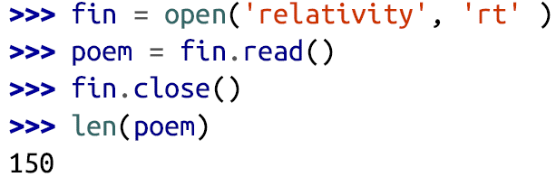
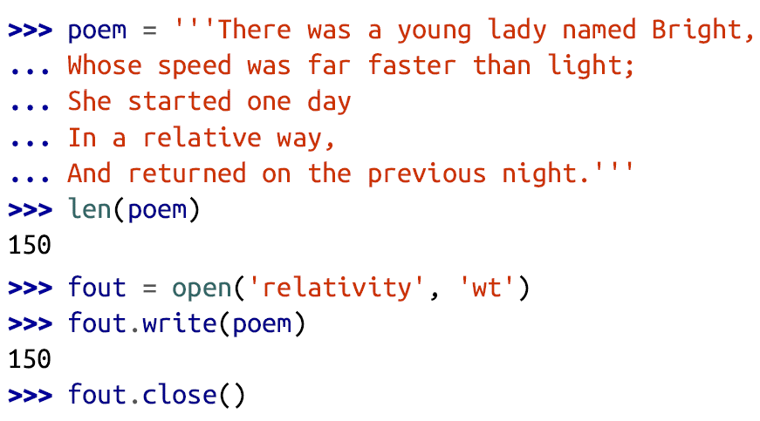
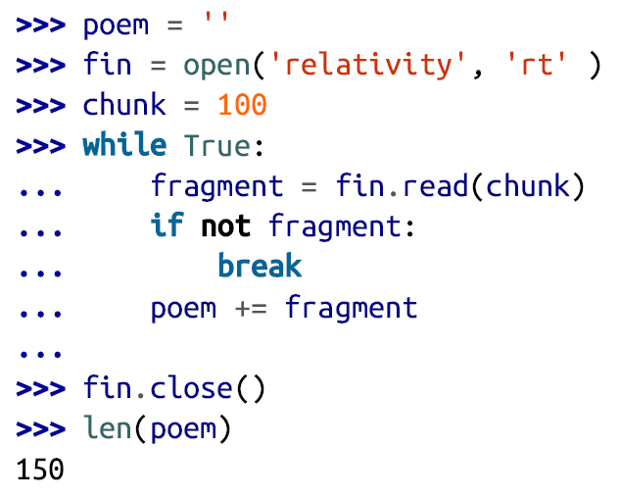
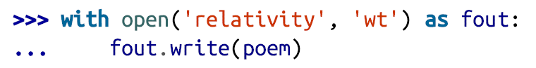
3. Files and Directories
A file is a sequence of bytes, stored in some filesystem, and accessed by a filename.
A directory is a collection of files, and possibly other directories.
open mode: w, r, x, a, t, b

Slide 21
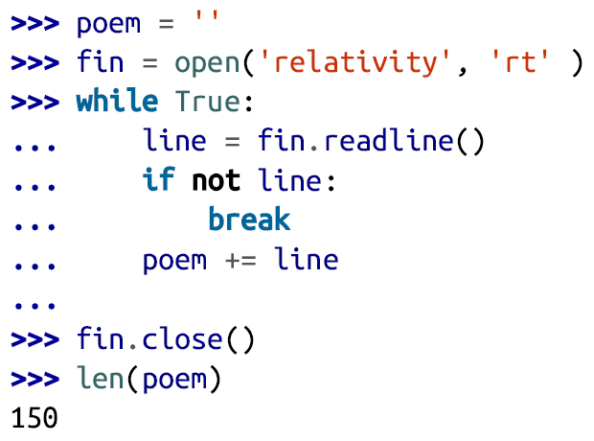
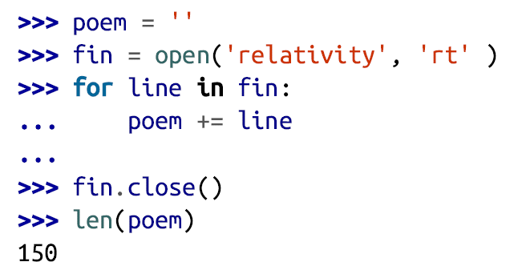

Three other ways of reading a file
string: a line at a time
iterator: a line at a time
a list of one-line strings

Slide 22








File and Directories Operations

Slide 23







Process Management

Slide 24




4. Modules and Packages
A module is just a file of any Python code.

Slide 25



Packages
The Module Search Path
A package is a subdierctory that organizez modules into file hierarchies.
Documentation

Slide 26



Installing Packages
https://pypi.org/project/biopython/
$ pip install biopython
$ git clone https://github.com/biopython/biopython.git
$ cd biopython
$ python setup.py build
$ python setup.py test
$ sudo python setup.py install
https://anaconda.org/conda-forge/biopython
$ conda install -c conda-forge biopython

Slide 27

5. Python and Bioinformatics
$ /usr/software/anaconda3/bin/makeblastdb -dbtype nucl -parse_seqids -in sequence.fasta
$ /usr/software/anaconda3/bin/ blastn -query sequence.fasta -db sequence.fasta -outfmt 6 -out blastn.txt
$ less blastn.txt

Slide 28


get_IR_fasta.py

Slide 29

GenBank visualization

Slide 30

Visualization of tRNA gene annotations
Exercise: modify the plot.py script to get more beautiful visualizations.

Slide 31
Thanks!

